Slide 1
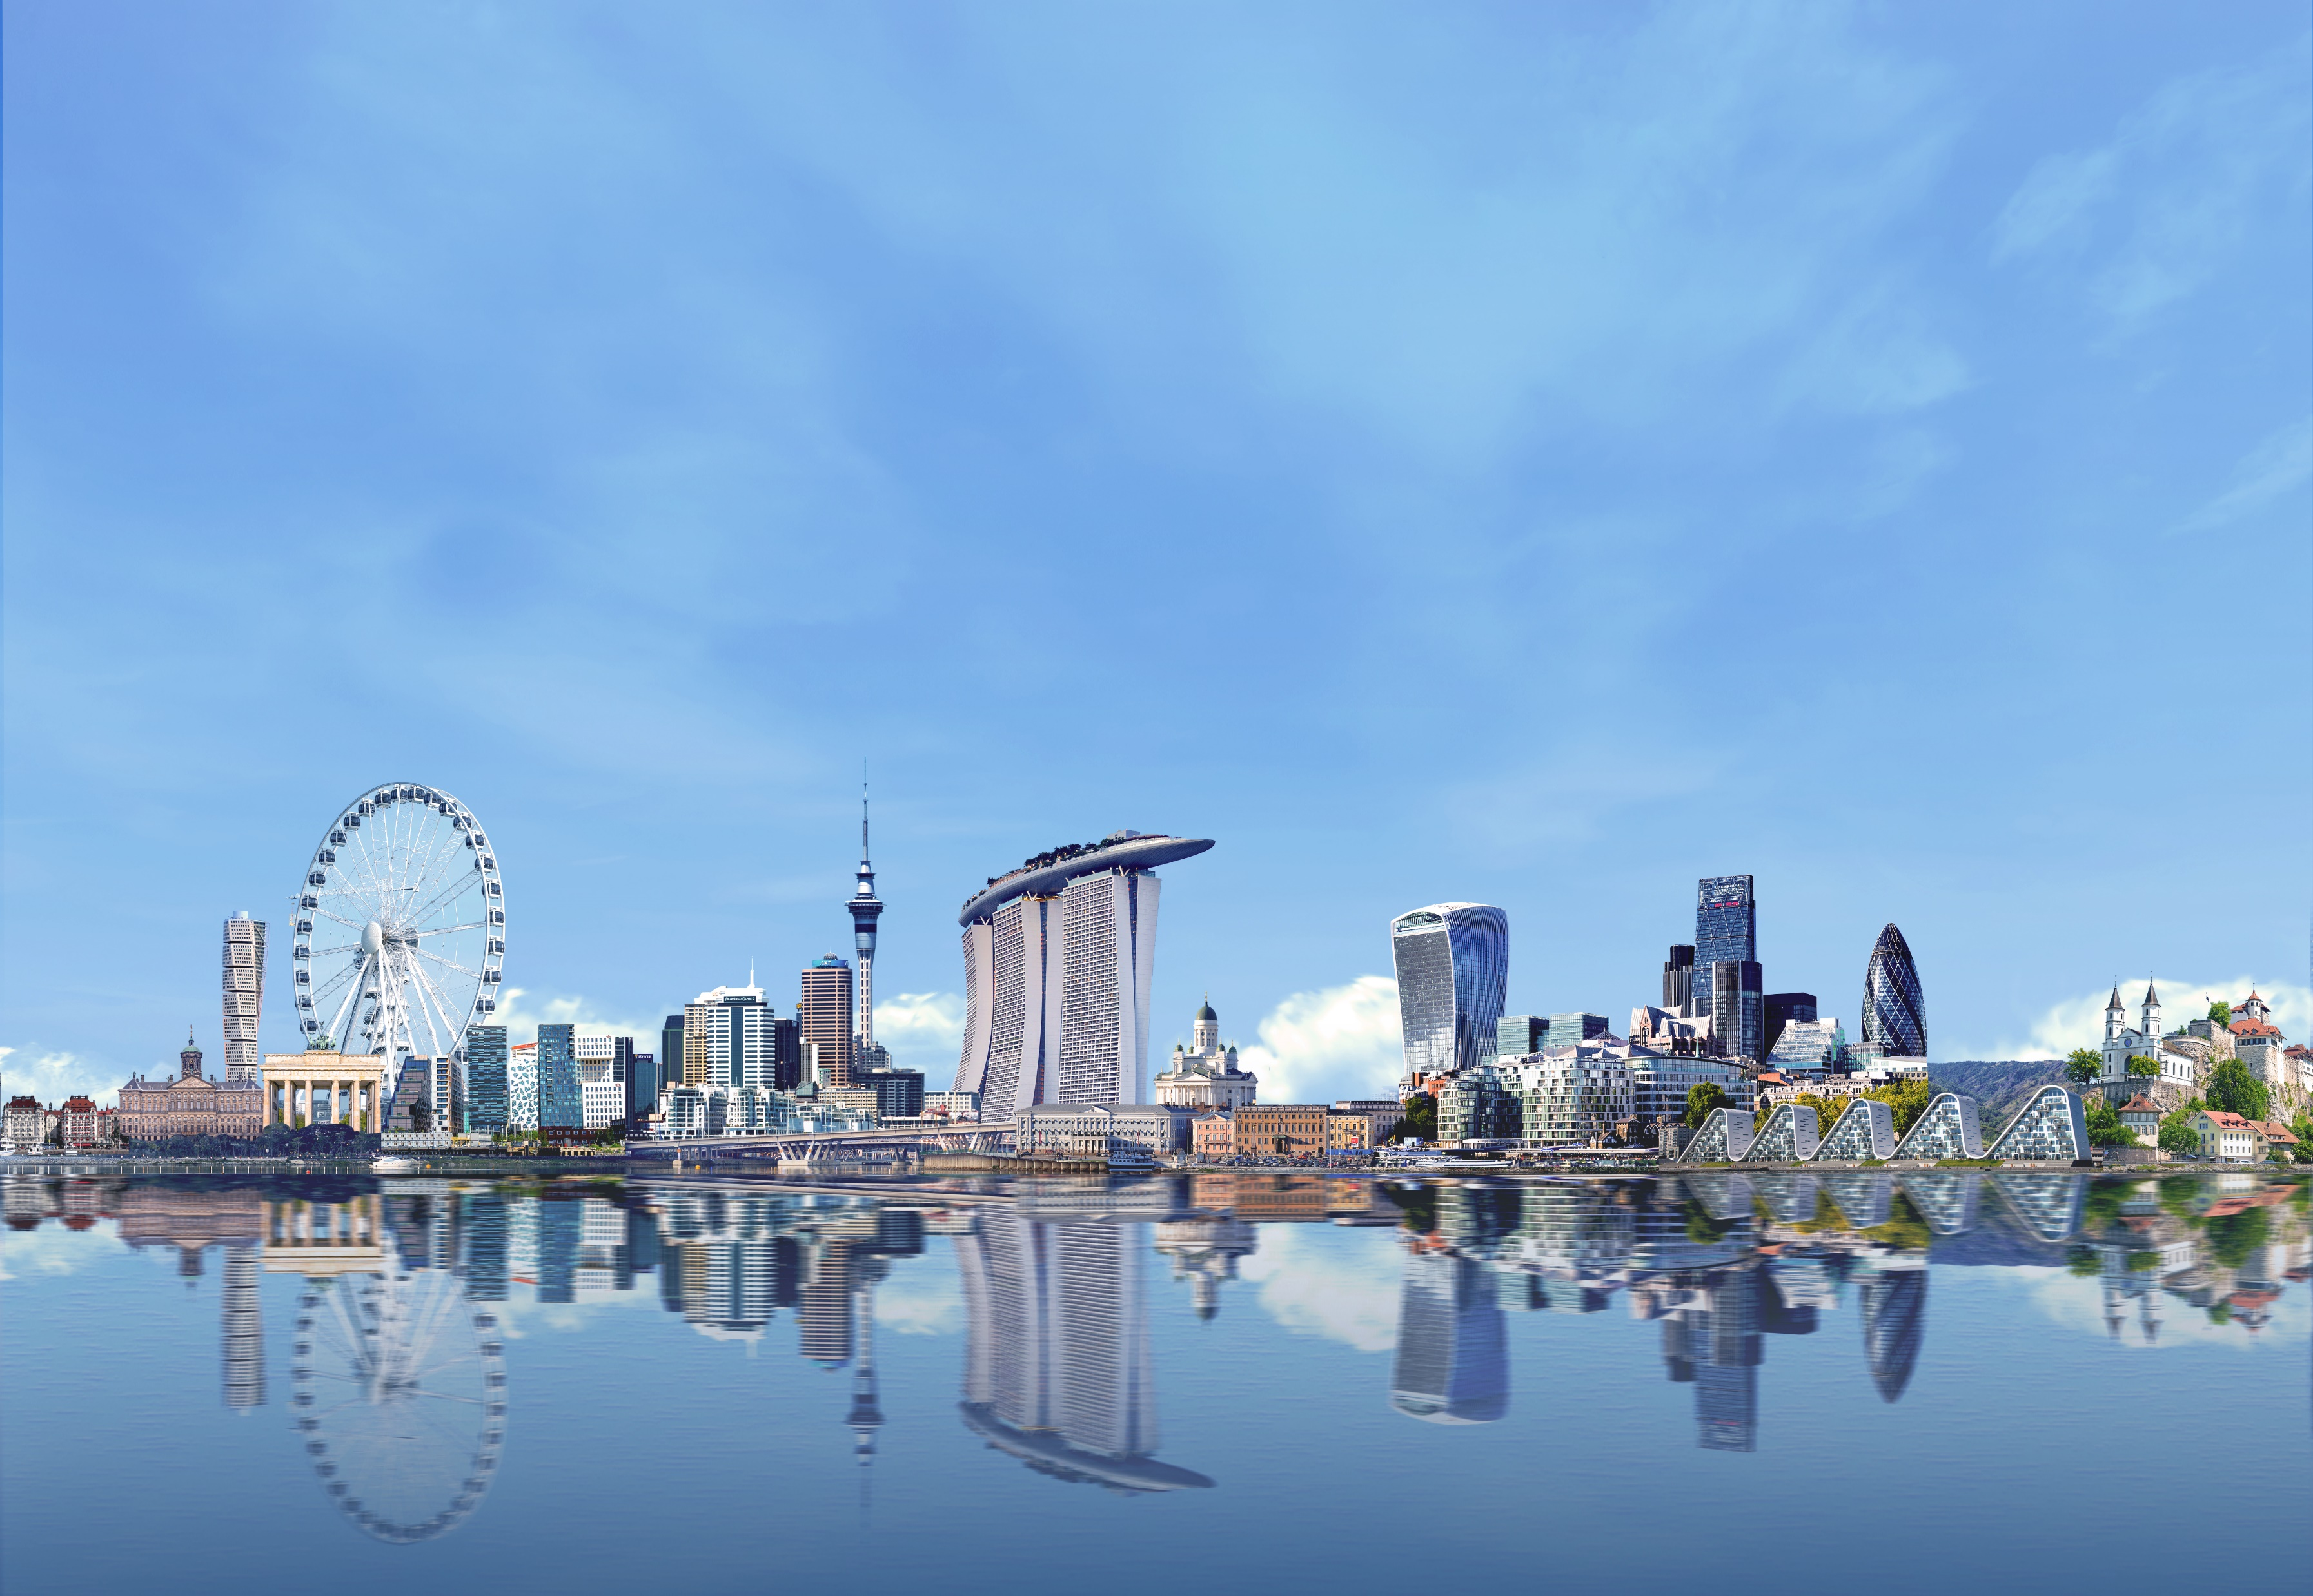



Slide 2



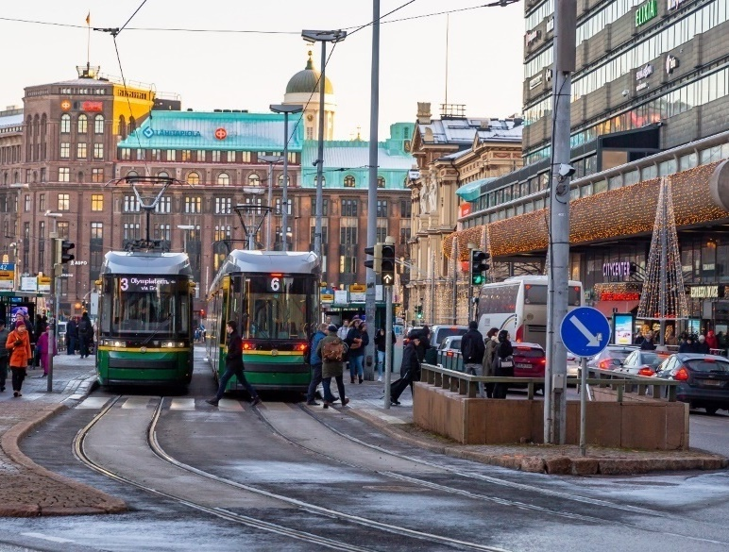
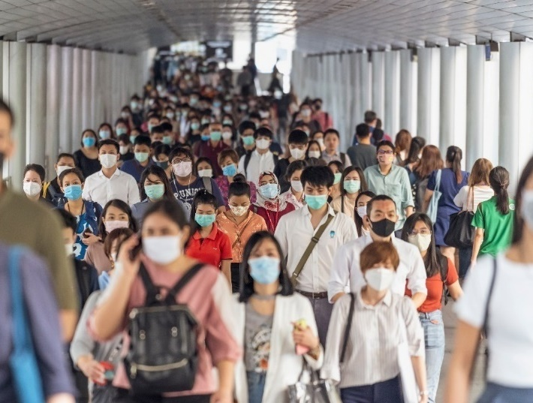
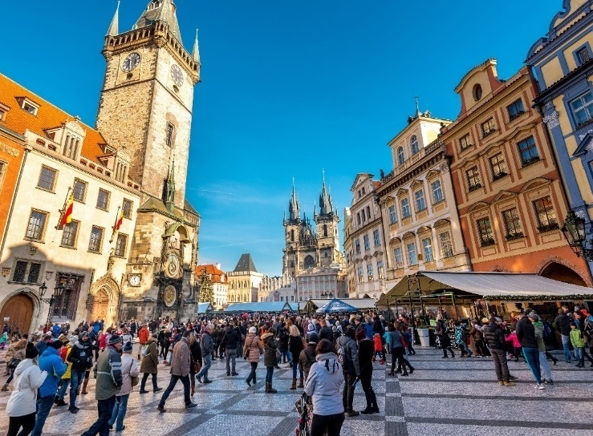

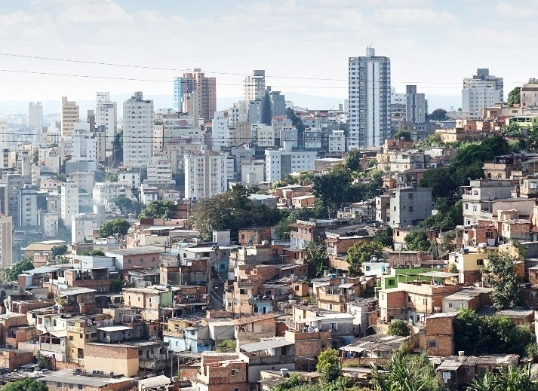
What is good government?

Slide 3


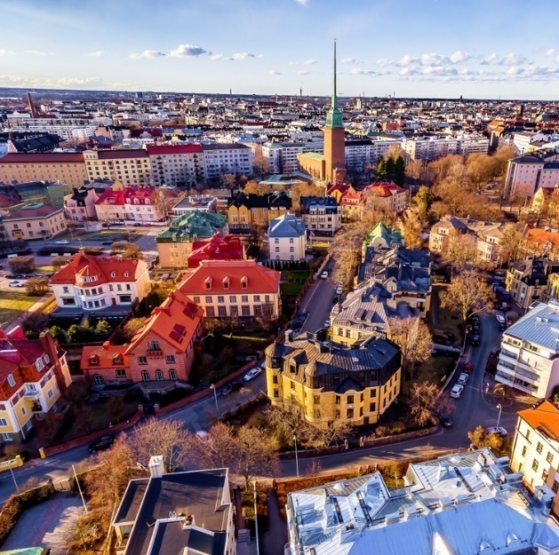
National Governance and National Prosperity are Deeply Connected
Government
capabilities matter
Effective governments create opportunities for citizens to thrive
Good governance
leads to better outcomes and increased public trust

Slide 4







All Governments Need to Build Capabilities

Slide 5
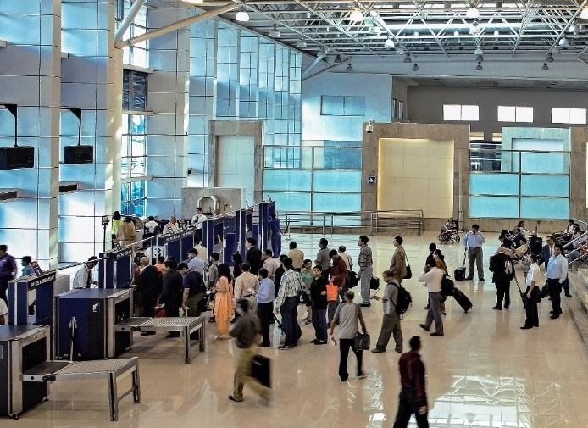
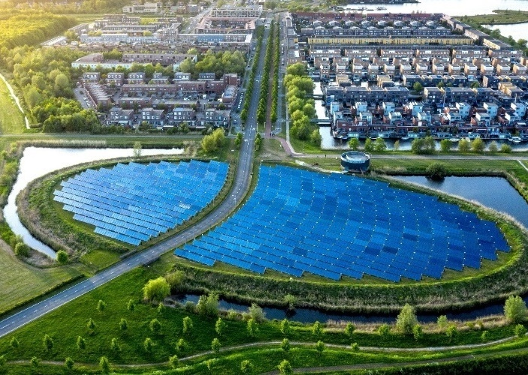
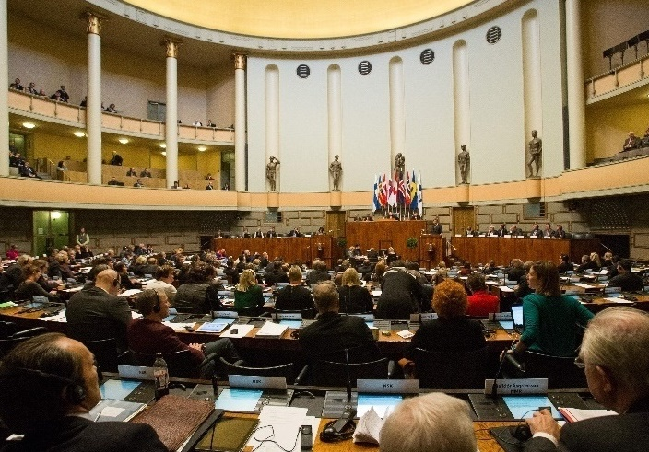
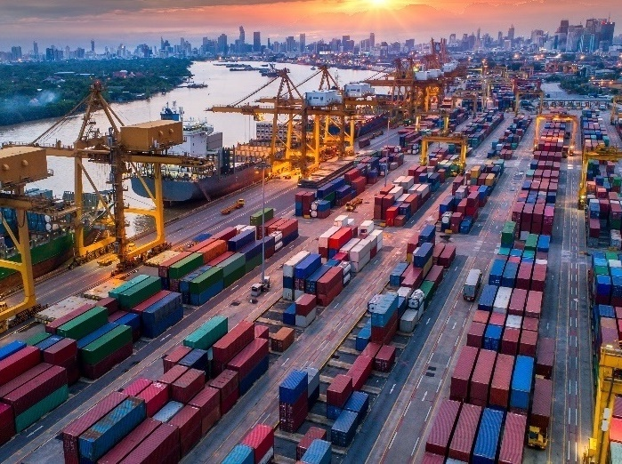
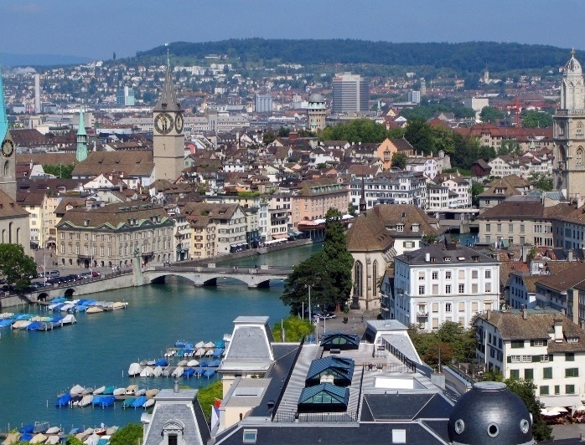



What are the capabilities that matter?

Slide 6













Dr Reuben
Abraham
Ms Elizabeth
Anderson
CEO of Artha Global
Government Leaders
and Practitioners
Executive Director of the World Justice Project
Dr Christian
Bason
Mr Adrian
Brown
CEO of the Danish Design Centre
v
Executive Director of the Centre for Public Impact
Ms Nathalie
Delapalme
Researchers and
Academics
Governance and
Index Experts
Dr Ed Olowo-Okere
Executive Director of the
Mo Ibrahim Institute
Director of the Global Governance Practice at the World Bank
Dr Manuel Gerardo
Flores Romero
Prof Kent Weaver
Coordinator of the Regulatory Policy Programme in Latin America of the OECD
Professor of Public Policy & Government at Georgetown University
CGGI Advisory
Panel

Slide 7
The Index Framework
PILLARS
Leadership & Foresight
Robust Laws & Polices
Strong Institutions
Financial Stewardship
Attractive Marketplace
Global Influence & Reputation
Helping People Rise
Anti-Corruption
Long-Term Vision
Adaptability
Strategic Prioritisation
Innovation
Rule of Law
Quality of Judiciary
Transparency
Regulatory Governance
Coordination
Data Capability Implementation
Quality of Bureaucracy
Government Debt
Country Budget Surplus
Efficient Spending
Country Risk Premium
Property Rights
Macroeconomic Environment
Attracting Investments
Logistics Competence
Stable Business Regulations
International Trade
International Diplomacy
Nation Brand
Passport Strength
Education
Health
Satisfaction with Public Services
Personal Safety
Environmental Performance
Income Equality
Social Mobility
Gender Gap
Non- Discrimination
Ethical Leadership *
Tax Efficiency *

Slide 8
Top 30 Countries
Country |  | Overall Rank
 | Finland | 1
 | Switzerland | 2
 | Singapore | 3
 | Denmark | 4
 | Netherlands | 5
 | Norway | 6
 | Sweden | 7
 | Germany | 8
 | New Zealand | 9
 | United Kingdom | 10
Country |  | Overall Rank
 | Ireland | 11
 | Austria | 12
 | Canada | 13
 | Estonia | 14
 | Japan | 15
 | France | 16
 | Australia | 17
 | United States | 18
 | Iceland | 19
 | South Korea
Country |  | Overall Rank
 | Belgium | 21
 | Czech Republic | 22
 | Slovenia | 23
 | United Arab Emirates | 24
 | Portugal | 25
 | Spain | 26
 | Israel | 27
 | Poland | 28
 | Lithuania | 29
 | Latvia | 30
■ – increased in rank
■ – decreased in rank

Slide 9
Anti-Corruption is closely correlated with
good governance

Slide 10
Good Governments are Less Corrupt

Slide 11
Why Government Capabilities Matter
in the Fight against Corruption

Slide 12
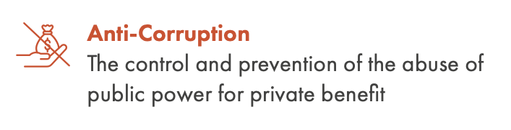
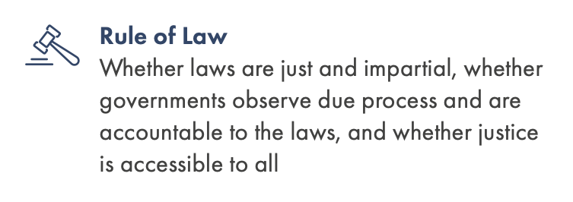
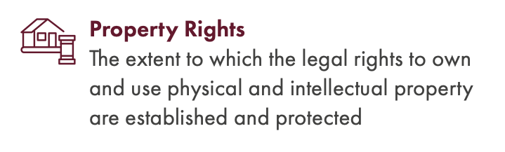
Capabilities Most Closely Correlated with Good Governance

Slide 13
Anti-Corruption capabilities are vital for a government to be effective and achieve good outcomes

Slide 14
Anti-Corruption is Closely Linked with Helping People Rise

Slide 15
Low Corruption Enables Countries to Prosper
In the 2021 Transparency International Corruption Perceptions Index, the top 30 countries are all high-income countries.
But in the bottom 40,
none are high-income countries.

Slide 16
Good Governments Tend to Have Higher Income Levels
Intercepts
X-intercept: Overall Index Capabilities Average Score (0.524)
Y-intercept: Overall Index Outcomes Average Score (0.579)
High Income
Upper-middle Income
Lower-middle Income
Low Income

Slide 17
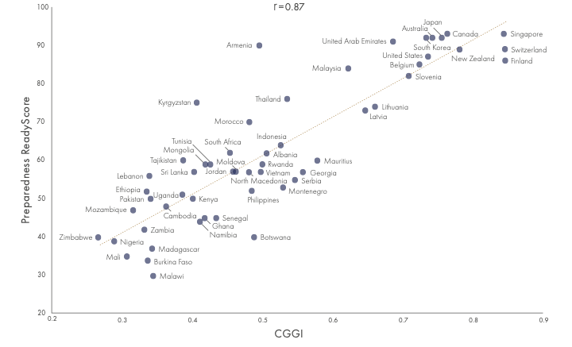
Good Governments are Better Prepared for Pandemics
Good governance explains the difference in pandemic preparedness between countries better than GDP per capita.

Slide 18
Anti-Corruption is closely correlated with other important public sector capabilities

Slide 19
Less Corrupt Governments Have Better Property Rights Protection

Slide 20
Anti-Corruption is Closely Linked with Robust Laws & Policies

Slide 21
Less Corrupt Governments Have Stronger Rule of Law

Slide 22
Anti-Corruption is Closely Linked with Quality of Judiciary

Slide 23
Less Corrupt Countries Have More Effective Public Institutions

Slide 24
Governments need to invest in developing good capabilities in anti-corruption and other areas

Slide 25




Anti-Corruption is a Whole-of-Government Effort
Robust laws and regulations and impartial, effective judiciary
Effective anti-corruption investigation agencies
Good public awareness, communications and education
Far-sighted leadership with strong political will
Well trained police and law enforcement agencies
Civil service ethos and values
Systems, processes and controls within all government agencies
All content is copyright and property of the Chandler Institute of Governance or the respective owners as stated. No unauthorised distribution or use is permitted. All rights reserved.
Notes:
Anti-corruption efforts cannot just be left to the responsibility of anti-corruption investigation agencies or commissions. Needs a whole-of-government effort to succeed. This also means that a wide range of capabilities across domains like organisational and system design, leadership, communications, operations, project management, legislative drafting, HRM, finance, law enforcement and training will be necessary to effectively create public sector environments that are hostile to corrupt practices.

Slide 26
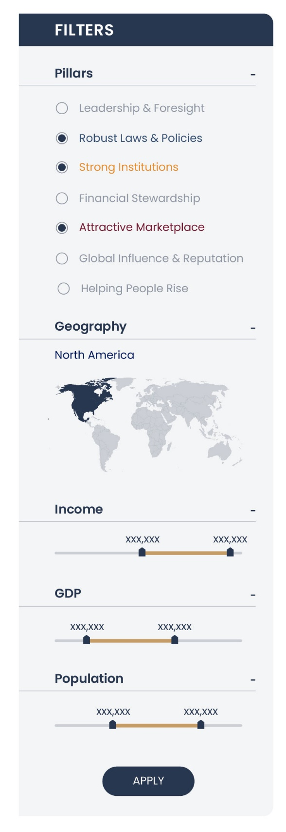
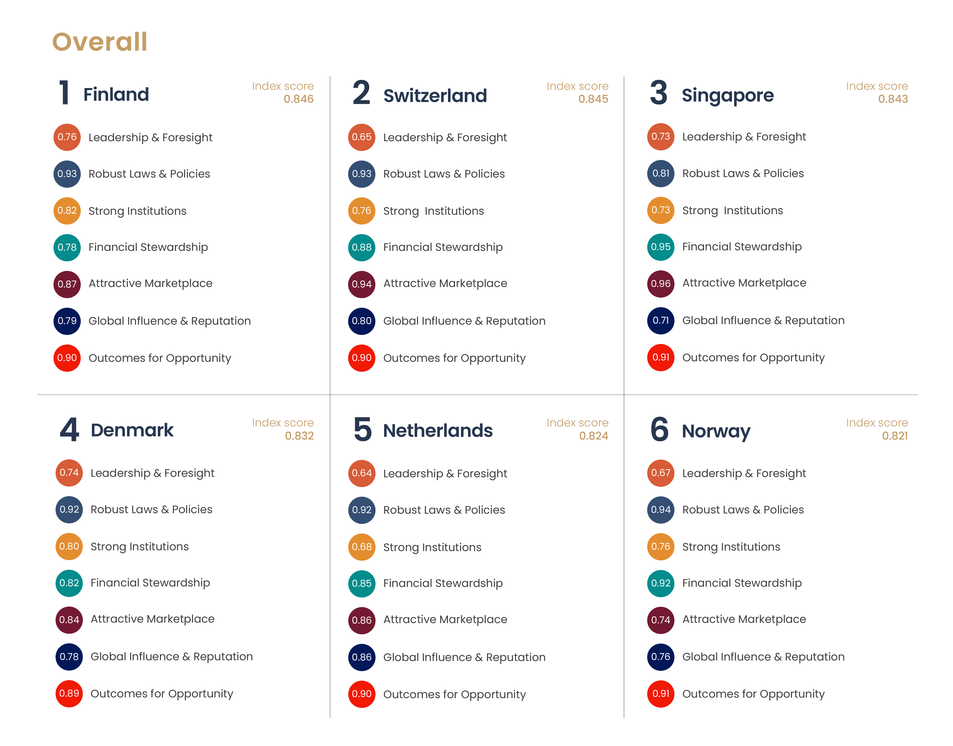
Using the CGGI - Filtering Results
Filter the results and select criteria to compare the country rankings and scores

Slide 27
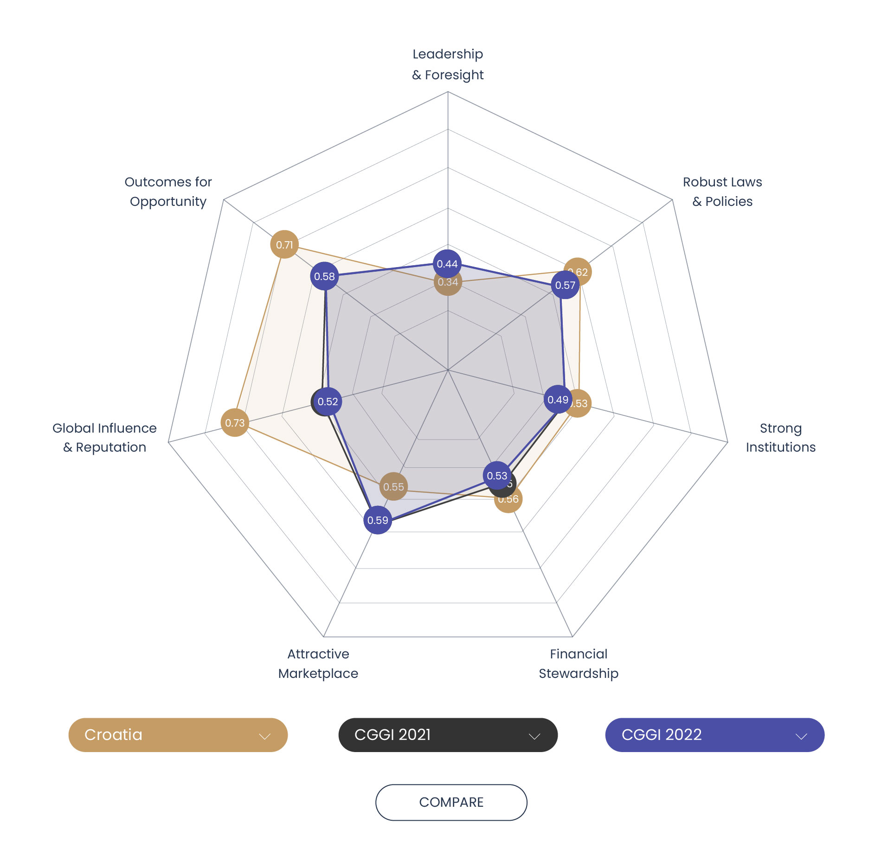
Using the CGGI - Comparing Countries
Build a spider graph to compare results between up to three countries
0.48
0.34
 | LF | RL | SI | FS | AM | GI | HPR
2022 | 0.442 | 0.568 | 0.492 | 0.529 | 0.591 | 0.524 | 0.579
2021 | 0.442 | 0.565 | 0.492 | 0.546 | 0.593 | 0.529 | 0.579

Slide 28
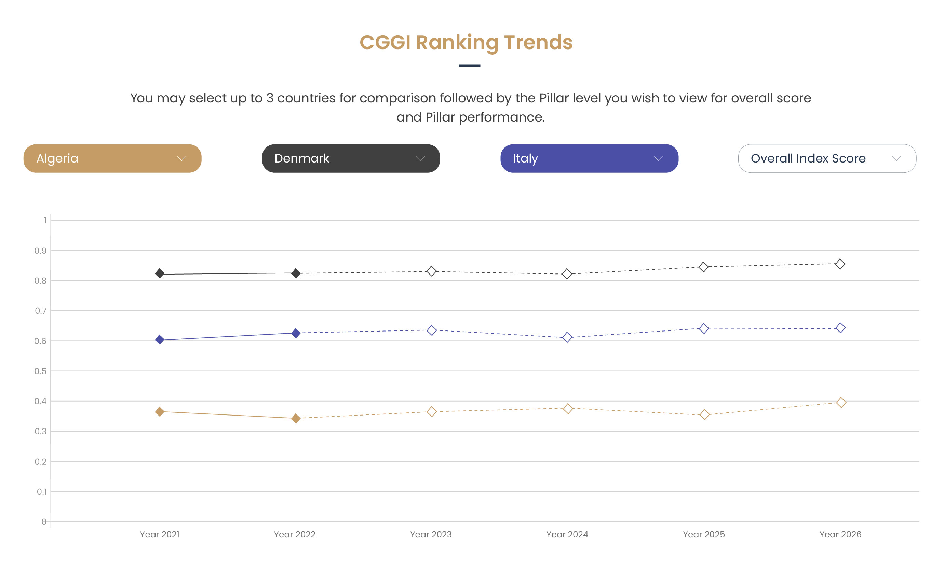
Using the CGGI - Comparing Countries
Build a trend chart to compare results between up to three countries

Slide 29
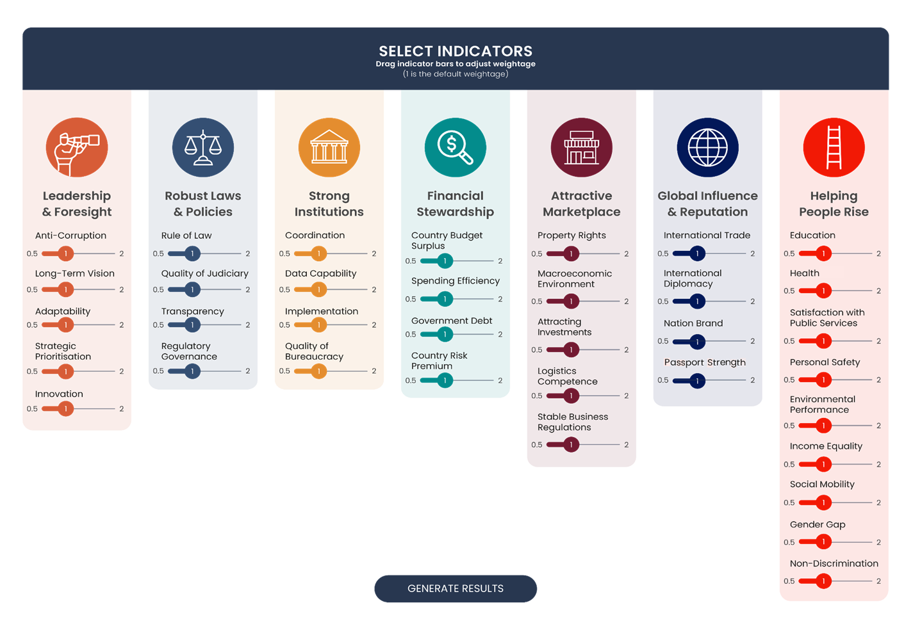
Using the CGGI - Customising Weights

Slide 30






Trust in Governance
Visit the CGGI website at www.chandlergovernmentindex.com
Follow CIG, @ChandlerINST on
Learn more, by exploring
the CGGI Website
Scan the QR code to view website

Slide 31
List of 104 Countries (option 1)
■ – increased in rank
■ – decreased in rank
Country | Overall Rank | Overall Score
Finland | 1 | 0.846
Switzerland | 2 | 0.845
Singapore | 3 | 0.843
Denmark | 4 | 0.832
Netherlands | 5 | 0.824
Norway | 6 | 0.821
Sweden | 7 | 0.820
Germany | 8 | 0.806
New Zealand | 9 | 0.780
United Kingdom | 10 | 0.778
Ireland | 11 | 0.771
Austria | 12 | 0.764
Canada | 13 | 0.763
Estonia | 14 | 0.757
Japan | 15 | 0.755
France | 16 | 0.744
Australia | 17 | 0.742
United States | 18 | 0.735
Iceland | 19 | 0.733
South Korea | 19 | 0.733
Belgium | 21 | 0.723
Czech Republic | 22 | 0.711
Slovenia | 23 | 0.708
United Arab Emirates | 24 | 0.686
Portugal | 25 | 0.682
Spain | 26 | 0.676
Country | Overall Rank | Overall Score
Israel | 27 | 0.674
Poland | 28 | 0.668
Lithuania | 29 | 0.660
Latvia | 30 | 0.646
Chile | 31 | 0.641
Malaysia | 32 | 0.622
Hungary | 33 | 0.605
Italy | 34 | 0.604
Bulgaria | 35 | 0.596
Uruguay | 36 | 0.591
Croatia | 37 | 0.587
Mauritius | 38 | 0.578
Romania | 39 | 0.570
China | 40 | 0.558
Georgia | 41 | 0.557
Costa Rica | 42 | 0.551
Russian Federation | 43 | 0.548
Serbia | 44 | 0.546
Kazakhstan | 45 | 0.544
Thailand | 46 | 0.535
Greece | 47 | 0.533
Montenegro | 48 | 0.529
Indonesia | 49 | 0.525
Mexico | 50 | 0.524
Panama | 51 | 0.509
India | 52 | 0.508
Country | Overall Rank | Overall Score
Albania | 53 | 0.505
Colombia | 54 | 0.502
Rwanda | 55 | 0.499
Vietnam | 56 | 0.498
Armenia | 57 | 0.495
Turkey | 58 | 0.490
Ukraine | 59 | 0.489
Botswana | 60 | 0.488
Jamaica | 61 | 0.485
Peru | 61 | 0.485
Philippines | 63 | 0.484
Morocco | 64 | 0.481
North Macedonia | 65 | 0.480
Brazil | 66 | 0.479
Argentina | 67 | 0.476
Moldova | 68 | 0.461
Jordan | 69 | 0.459
South Africa | 70 | 0.453
Senegal | 71 | 0.433
Tunisia | 72 | 0.425
Egypt, Arab Rep. | 73 | 0.418
Ghana | 73 | 0.418
Mongolia | 73 | 0.418
El Salvador | 76 | 0.415
Honduras | 77 | 0.414
Namibia | 78 | 0.411
Country | Overall Rank | Overall Score
Bosnia and Herzegovina | 79 | 0.408
Kyrgyzstan | 80 | 0.406
Sri Lanka | 81 | 0.402
Kenya | 82 | 0.400
Tanzania | 83 | 0.390
Ecuador | 84 | 0.386
Tajikistan | 84 | 0.386
Uganda | 84 | 0.386
Nicaragua | 87 | 0.381
Algeria | 88 | 0.376
Guatemala | 89 | 0.373
Cambodia | 90 | 0.362
Malawi | 91 | 0.344
Nepal | 92 | 0.342
Madagascar | 92 | 0.342
Pakistan | 94 | 0.340
Lebanon | 95 | 0.338
Burkina Faso | 96 | 0.336
Ethiopia | 97 | 0.335
Zambia | 98 | 0.331
Mozambique | 99 | 0.315
Iran, Islamic Rep. | 100 | 0.314
Mali | 101 | 0.306
Nigeria | 102 | 0.288
Zimbabwe | 103 | 0.266
Venezuela | 104 | 0.166

